Slide 1

Code Refactoring and Bug Fixing
Report By: Sathvika Doddivenuka
InternID: IN1240079

Slide 2
About me
I am a dedicated and enthusiastic individual with a robust background in technology and a profound interest in data science. Currently pursuing my Bachelor of Technology degree, I am deeply committed to utilizing my skills and knowledge to make meaningful contributions to the field of data science. With a solid grasp of programming, mathematics, and analytical techniques, I am excited about the opportunity to apply these abilities to solve real-world problems and derive valuable insights from data. I possess proficiency in Python at an intermediate level and am adept at using SQL for data manipulation and analysis. Additionally, I am familiar with essential data analysis tools such as Pandas and NumPy and have experience in data visualization using libraries like Matplotlib and PowerBI.
GITHUB: https://github.com/Sathvigoud
LINKEDIN: https://www.linkedin.com/in/sathvika-doddivenuka-93a738205/

Slide 3
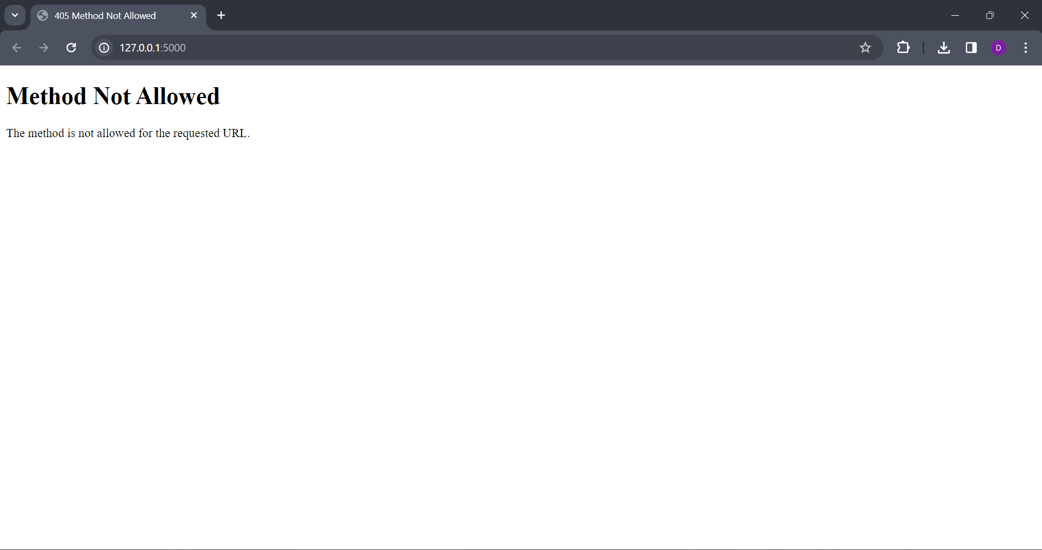
OBJECTIVE OF THE PROJECT
Refactor the existing codebase and ensure the proper functioning of the Note Taking Application.
Document all the identified bugs during the debugging process.
ISSUE:

Slide 4

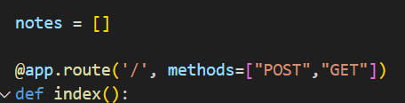
Debugging
1. Missing GET request handling:
The index() function only handles POST requests.
To display the initial page with notes we need to add a route for GET requests.
The following code will fix the error and display the notes we entered.

Slide 5
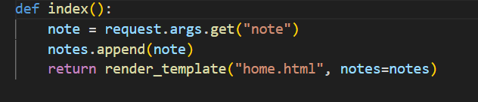
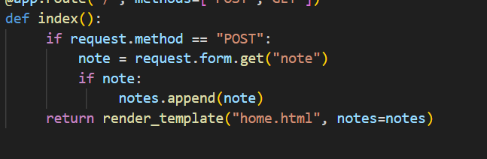
.
2. Incorrect approach for accessing form data:
request.args is used for accessing query parameters in the URL, not form data.
We should use request.form to access data from a POST form.
Even if the notes are empty the above code adds them to the notes list. But the following code is checking if the note has a value before appending it.

Slide 6
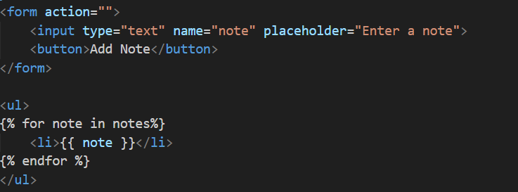
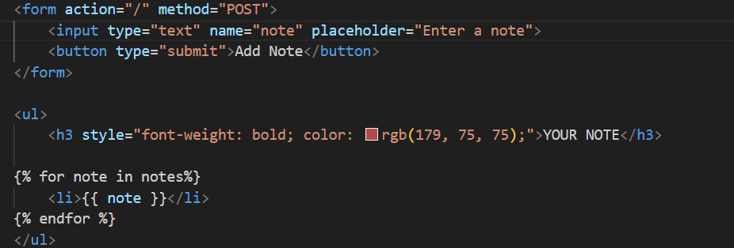
.
3. Issues with HTML form tag:
The form element is missing a crucial attribute, method. This attribute specifies how the form data should be submitted to the server.
The action attribute is present, but its value is an empty string (""). This attribute specifies the URL on the server where the form data will be sent.
Since we want to direct it to the same page let’s define action=“/”

Slide 7
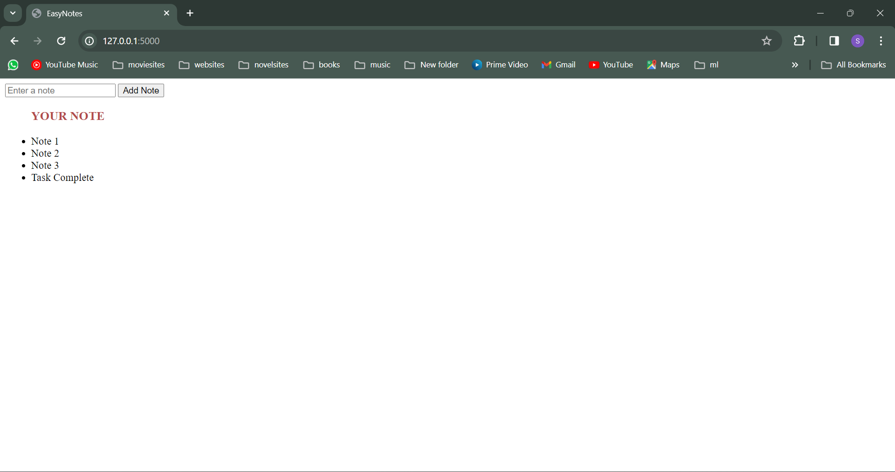
OUTPUT
.

Slide 8

THANK YOU

